Slide 1
Decoding OTT: Uncovering global insights for film industry advancement and cultural exchange.
Presented by
Vidisha Arvind(E23MTCG0004)
Abhay Kumar(E23MCAG0134)
Ayush Kumar(E23MCAG0132)
Submitted
To
Dr. Nitin Arvind shelke
(Assistant Professor)
DEPARTMENT OF SCHOOL OF COMPUTER SCIENCE ENGINEERING & TECHNOLOGY
BENNETT UNIVERSITY, GREATER NOIDA, 201310, UTTAR PRADESH, INDIA

Slide 2
Outline
Introduction
Literature Review
Problem Statement
Proposed Techniques
Block Diagram
Techstack & IDE
Database
Methodology
EDA
Results

Slide 3
Introduction
Over-the-top (OTT) platforms have transformed the entertainment business and have had a huge influence on worldwide reach.
OTT analysis can potentially be used to propose content and improve the user experience as well as profit businesses.
Which may help steer decisions about which locations to grow into, what material to licence or generate for certain markets, and so on.

Slide 4
Literature Review
Research Papers and Journals | Methodology | Results
Kurre, A. (2023, April 30). Comparative Analysis: Machine Learning Usage Across Recommender Systems of OTT Platforms. vidhyayanaejournal.org. https://doi.org/10.58213/vidhyayana.v8i5.689 | Challenge in recommendation.The cold start problem involves recommending content to new users without feedback, data sparsity involves recommending content with diverse preferences. | Netflix employs various machine learning algorithms in their recommendation engine, including KNN, deep learning, Restricted Boltzmann Machines , and Singular Value Decomposition in their recommendation engine. Spotify, Amazon Prime Video, and Disney+Hotstar also use similar methods, including collaborative filtering, object attribute, social similarity, and matrix factorization models.
M5: Multi-Modal Multi-Interest Multi-Scenario Matching for Over-the-Top Recommendation | Proceedings of the 29th ACM SIGKDD Conference on Knowledge Discovery and Data Mining. ACM Conferences. https://doi.org/10.1145/3580305.3599863 | This paper discusses the Multi-Modal Multi-Interest Multi-Scenario Matching (M5) methodology, a recommendation system that utilizes Over-the-Top (OTT) platforms' unique characteristics. It explains how M5 enhances user experience by utilizing multi-modal embedding, multi-interest extraction, multi-scenario mixing, and weighted candidate matching layers. | The M5 method significantly enhanced the hours per visitor, long-term retention, and advertising revenue, resulting in a superior user experience for millions of people.

Slide 5
Literature Review
Research Papers and Journals | Methodology | Results
Khare, N., & Jhapate, A. (2022). Review on Collaborative Filtering Machine Learning Approach for Recommendation Systems. Research Journal of Engineering Technology and Medical Sciences (ISSN: 2582-6212), 5(03). | The process includes estimating ratings and offering films to individuals based on their similarities to other users. The accuracy and precision metrics were used to assess the performance of approach. | Collaborative filtering is a technique for recommending films based on implicit user ratings or input from other users. They attempted to solve the issue of data sparsity by improving the recommendation process.
(2023, August 14). Polarity in sentiments using NLP: ML-based recommendation system. UOB Journals. https://journal.uob.edu.bh/handle/123456789/5197 | This study's approach included data collecting from a variety of sources, including two datasets from Rotten Tomatoes. The acquired data was preprocessed and organised, and sentiment analysis was carried out with the help of the TextBlob library. After then, the K-Nearest Neighbour (KNN) algorithm was used to propose films based on sentiment reviews. | The system correctly identified the sentiment of user reviews and used that data to make suggestions for better user experiences. Polarity attitudes were shown to be more influential in the recommender system than standard rating or category-based systems. To compare emotive data and propose related films, the KNN algorithm and cosine similarity were used.

Slide 6
Literature Review
Research Papers and Journals | Methodology | Results
Pre and Post COVID-19 sentiment Analysis of Consumers for OTT Platforms. Raka Ghosh Dastidar Psychology and Education Journal (2021) analysis of ott | Mendeley | Data was collected through web scraping from Twitter then sentiment analysis done on consumer mindset towards the OTT platform . Sentiment analysis was done by visualizing data in several phase with different emotion Categorization. | Result of analysis that more peoples are inclining towards the OTT platforms . Due to covid-19 huge loss observed in entertainment industry .
Suman Kumar & Rajendra Prasad Meena, The Rise of OTT Platform: Changing Consumer Preferences, International Journal of Management (IJM), 14(5), 2023, pp. 70-94. DOI: https://doi.org/10.17605/OSF.IO/AN69G , https://iaeme.com/MasterAdmin/Journal_uploads/IJM/VOLUME_14_ISSUE_5/IJM_14_05_007.pdf | sample size of 100 Respondents from undefined locations . structured questionnaire using google form as primary data collection.Random sampling to collect feedback from respondents.PCT computation for analysing questionnaire. | The study results in forecasting the destiny of ott platform.Encouraging your ott platform on your web page is huge setback to create traffic .

Slide 7
Problem Statement
Data from top OTT platforms such as Netflix and Hotstar will be analysed to get insights into audience preferences, market trends, and cultural interaction through films.
Exploration of worldwide data for a complete grasp of the industry then keeping current customers.
Solves customer churn problem and better content production, personalised suggestions, and market expansion.

Slide 8
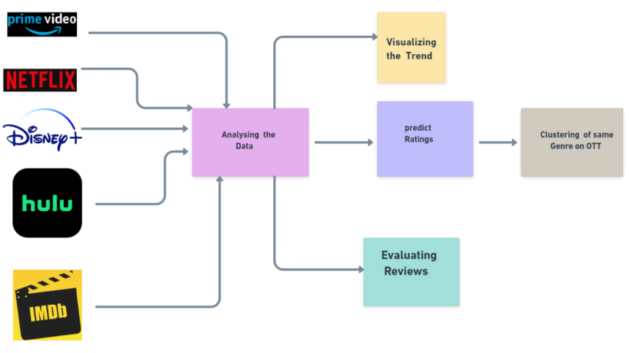
Block Diagram

Slide 9
Tools
IDE : Google Colab / Jupyter Notebook
Libraries like Keras , Numpy , Pandas , Nltk etc.
Visualization – Seaborn , Matplotlib , Plotly

Slide 10
Proposed techniques
The study analyzed the brand color palettes for Disney, Netflix, and Amazon, focusing on their visual elements and distribution of content types. We eliminated missing data and used imputation to fill in missing information.
The analysis also showed bar graphs to provide a comprehensive picture of the content environment, enabling strategic decisions about content generation and purchase.

Slide 11
Database
Netflix Dataset - https://www.kaggle.com/datasets/shivamb/netflix-shows
Amazon Prime Dataset- https://www.kaggle.com/datasets/shivamb/amazon-prime-movies-and-tv-shows
Hotstar Dataset - https://www.kaggle.com/datasets/shivamb/disney-movies-and-tv-shows
It’s A collection of movies and tv shows found on these streaming platforms.
Contains column like 'Title', 'Year_release', 'Directors', 'description', 'listen_in’, 'Language', 'Runtime' etc

Slide 12
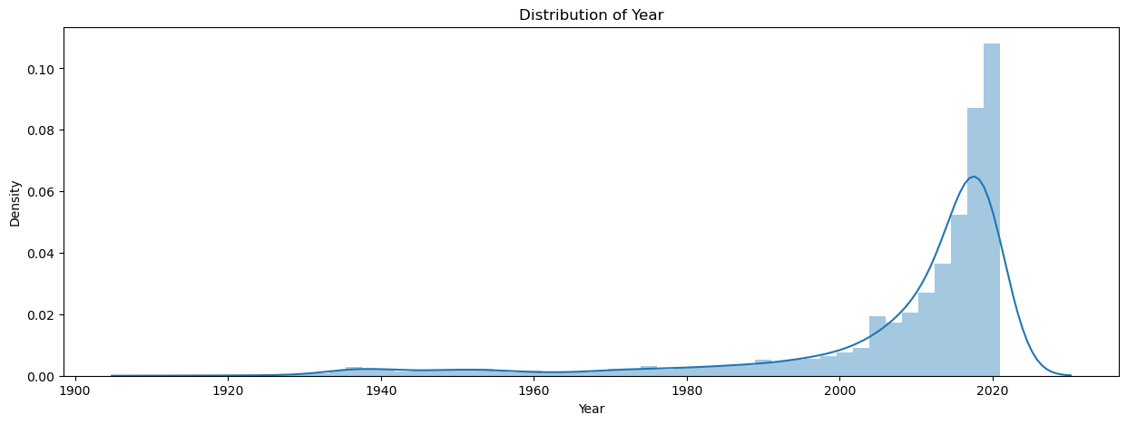
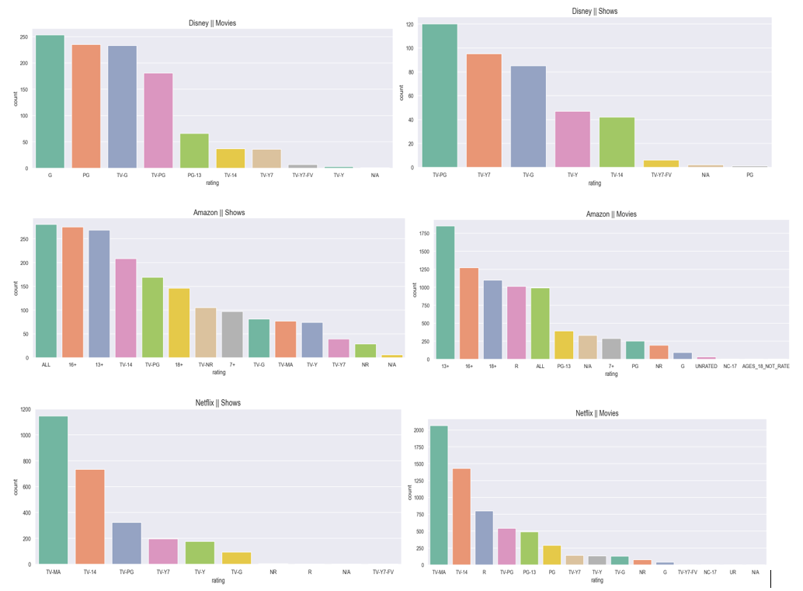
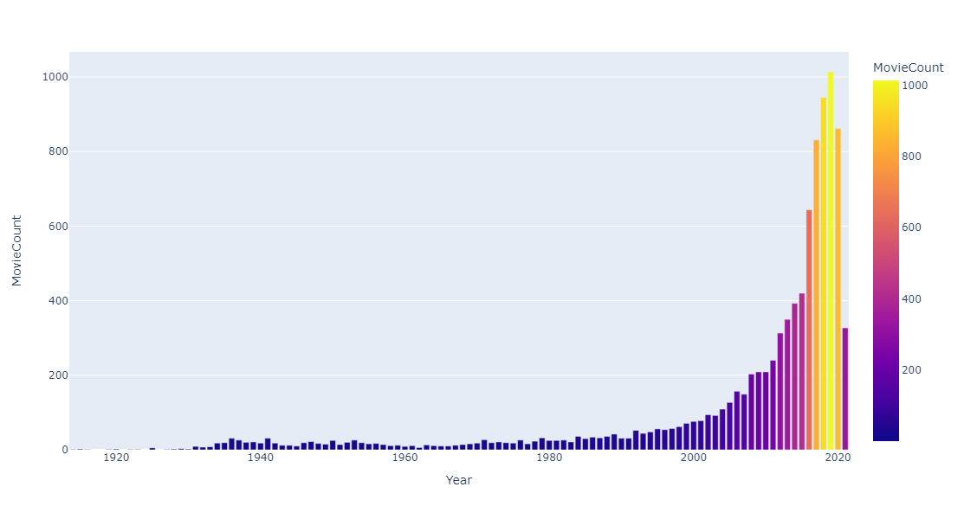
Data Visualization

Slide 13
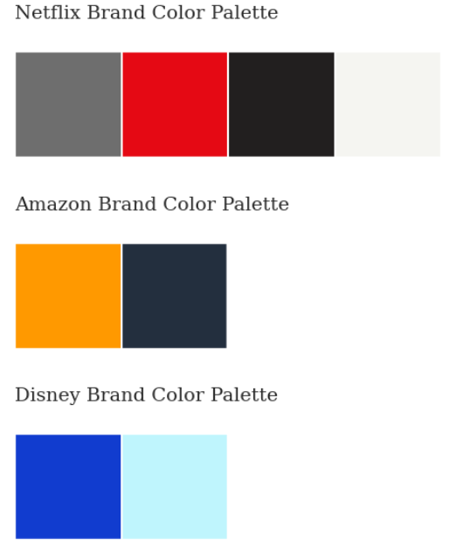
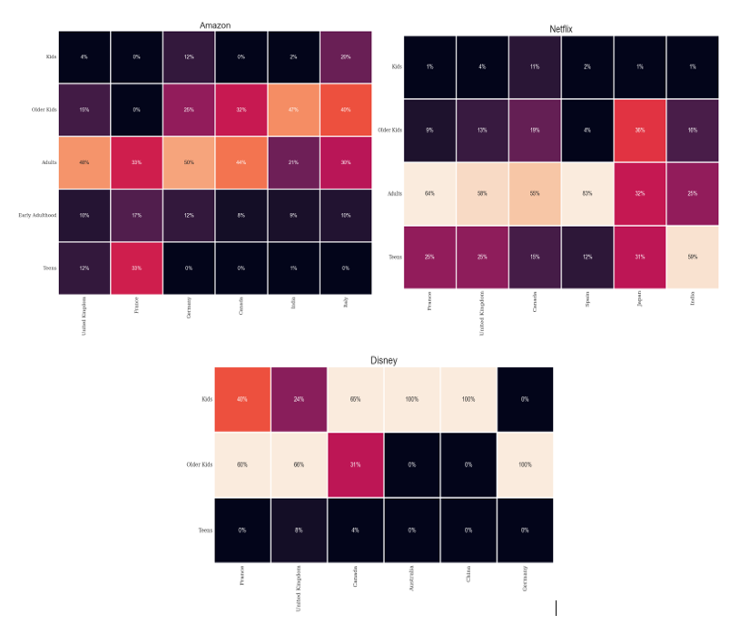
Methodology
Data preprocessing and cleaning were performed, and columns with multiple inputs were handled. Factors like number of films, score distribution, age, and duration were considered.
Brand color palettes, content distribution, and heatmaps were used to understand content creation patterns and audience preferences. This information helps platforms make strategic decisions about content generation and purchase.

Slide 14
Results
Netflix has a diverse content collection, attracting a wider audience than Amazon and Disney+. It regularly updates its programming, aiming to increase user engagement and loyalty. Platforms like Netflix target different age groups and have different preferences for content based on ratings.
This variety allows them to compete in a crowded industry and reach a wider audience. The USA, Canada, and the UK are major producers of content.

Slide 15
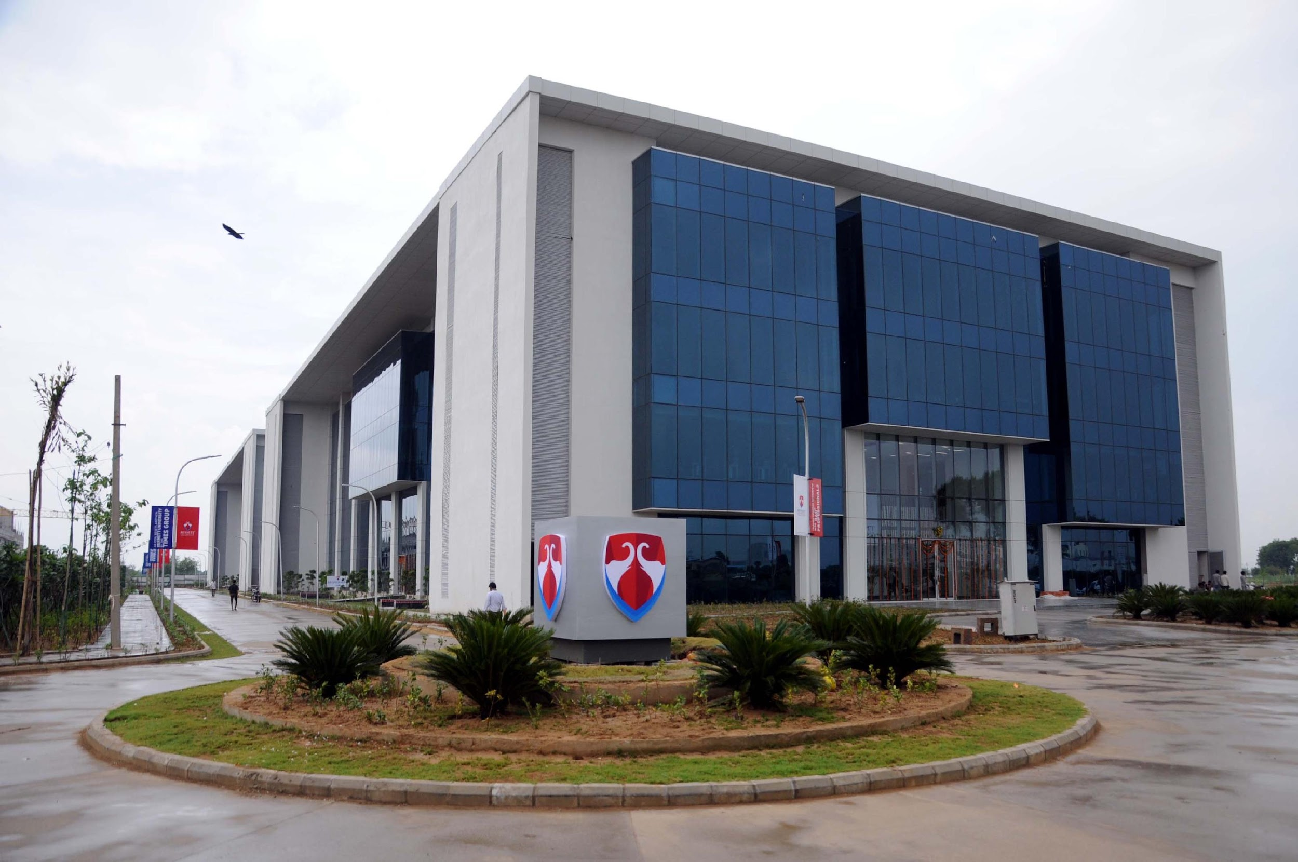
Thank You

